Slide 1
Cohen chap 5. Hypothesis Tests
“I’m afraid that I rather give myself away
when I explain,” said he.
“Results without causes are much more impressive.”
Sherlock Holmes
The Stock-Broker’s Cat
For EDUC/PSY 6600

Slide 2
Two General Types of research questions
Do groups significantly differ on 1 or more characteristics?
Comparing group means, counts, proportions
t-tests, ANOVA, χ² tests
Is there a significant relationship among a set of variables?
Testing the association or dependence
Correlation, regression

Slide 3
Inferential statistics
Are differences/associations LIKELY due to
SAMPLING ERROR
OR
TRUE
experimental/ phenomenological differences/processes?
Descriptive statistics are limited
Rely only on raw data distribution
Generally describe 1 variable
Do not address accuracy of estimators or hypothesis testing
How precise is sample mean or does it differ from a given value?
Are there between or within group differences or associations?
Goals of inferential statistics
Hypothesis testing
Parameter estimation
Repeated sampling
Estimators will vary from sample to sample
Sampling or random error → Variability due to chance
Are our results CONSISTENT with RANDOM VARIATION?
- - -
We are NOT asking if our results are IMPORTANT !
Need:
Theoretical knowledge,
measures of effect size,
or
confidence limits

Slide 4
Causality & statistics
Causality depends on evidence from outside statistics:
Phenomenological (educational/behavioral/biological) credibility
Strength of association – ruling out occurrence by chance alone
Consistency with past research findings
Temporality
Dose-response relationship
Specificity
Prevention
Causality is often a judgmental evaluation
of combined results from several studies

Slide 5
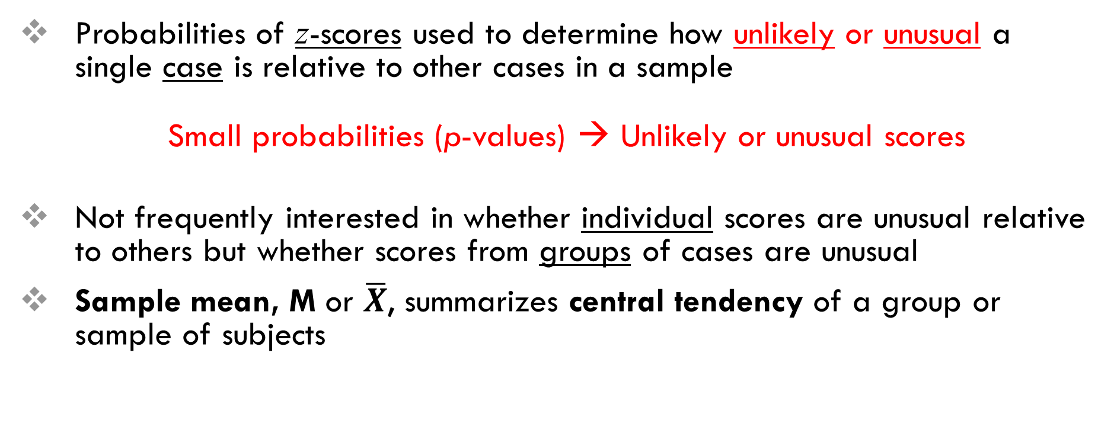
z-scores and Statistical Inference
Probabilities of z-scores used to determine how unlikely or unusual a single case is relative to other cases in a sample
Small probabilities (p-values) → Unlikely or unusual scores
Not frequently interested in whether individual scores are unusual relative to others but whether scores from groups of cases are unusual
Sample mean, M or $\overline{X}$, summarizes central tendency of a group or sample of subjects

Slide 6
Steps of a Hypothesis test
State the Hypotheses (Null & Alternative)
Select the Statistical Test & Significance Level
α level
One vs. Two tails
Select random sample and collect data
Find the region of Rejection
Based on α & # of tails
Calculate the Test Statistic
Examples include: z, t, F, χ²
Conclusion: Make the Statistical Decision
“p-value”
probability of observing
a test statistic
“as extreme or more extreme”
IF the NULL is true

Slide 7
Hypothesis
Hypotheses are always specified in terms of population
Null (nil) hypothesis for TWO population MEANS
H₀: μ₁ = μ₂
Research (alternative) hypothesis
H₁: μ₁ ≠ μ₂
H₁: μ₁ < μ₂
H₁: μ₁ > μ₂
Sometimes H_{A} is used

Slide 8
Rejecting the Null Hypothesis
Assumption: the NULL hypothesis is TRUE in the POPULATION
IF the p-value is very SMALL (p-value< α), it is UNLIKELY we would have observed a sample that extreme JUST DUE TO RANDOM CHANCE.
Can use the p-value< α OR test statistic < Critical Value
We either REJECT or FAIL TO REJECT the Null hypothesis
We NEVER ACCEPT the ALTERNATIVE!!!
“Innocent until proven guilty”
Not enough statistical evidence to reject…
Judgment suspended until further evidence evaluated:
“Inconclusive”… Larger sample? … Insufficient data?

Slide 9
1 or 2 tails?
Some circumstances may warrant
a 1-tailed test,
BUT...
We generally prefer and default to
a 2-tailed test!!!
More conservative
Rejection region is distributed in both tails
e.g.: α = 5% distributed across both tails
(2.5% in each tail)
If we know outcome, why do study?
Looks suspicious to reviewer’s…
“significant results at all costs!”
Cheating to run results then decide?
Yes! α = 7.5%
Can’t flip coin, say it will land on tails, then lands on heads, and switch and say that it will land on heads
1-tailed test suggests a directionality in results
H₁: μ₁ < μ₂
H₁: μ₁ > μ₂
Rejection region collapsed into 1 end of sampling distribution
e.g., α = 5% in one tail
No computational differences for test statistics
… ONLY the p-level differs …
1-tailed, p of event or more extreme event in one tail
2-tailed, p of event or more extreme event in both tails
p from 1-tailed*2 (2-sided: p = .06, 1-sided: p = .03)

Slide 10
Choosing alpha
type I error
We reject the NULL
when we shouldn’t have
The risk of “false positive” results
type II error
We FAIL to reject the NULL
when we should have
The risk of “false negative” results
Alpha = probability of making a type I error
We want α to be small, but…we can’t just make too tiny, since the trade off is increasing the type II error rate
Default is α = .05 (5% = 1 in 20 & seems ‘rare’ to humans) BUT there is nothing magical about it
Let it be LARGER value (α = .10) IF we’d rather not miss any potential relationship and are okay with some false positives
Ex) screening genes, early drug investigation, pilot study
Set it SMALLER (α = .01) IF false positives are costly and we want to be more stringent
Ex) changing a national policy, mortgaging the farm

Slide 11
Assumptions of a 1-sample z-test
Sample was drawn at random (at least as representative as possible)
Nothing can be done to fix NON-representative samples!
Can not statistically test
SD of the sampled population = SD of the comparison population
Very hard to check
Can not statistically test
Variables have a normal distribution
Not as important if the sample is large (Central Limit Theorem)
IF the sample is far from normal &/or small n, might want to transform variables
Look at plots: histogram, boxplot, & QQ plot (straight 45º line)
Skewness & Kurtosis: Divided value by its SE & > ± 2 indicates issues
Shapiro-Wilks test (small N): p < .05 → not normal
Kolmogorov-Smirnov test (large N):

Slide 12
APA: results of a 1-sample z-test
State the alpha & number of tails prior to any results
Report exact p-values (usually 2 decimal places), except for “p < .001”
Example Sentence:
A one sample z test showed that the difference in the quiz scores between the current sample (N = 9, M = 7.00, SD = 1.23) and the hypothesized value (6.000) were statistically significant, z = 2.45, p = .040.

Slide 13
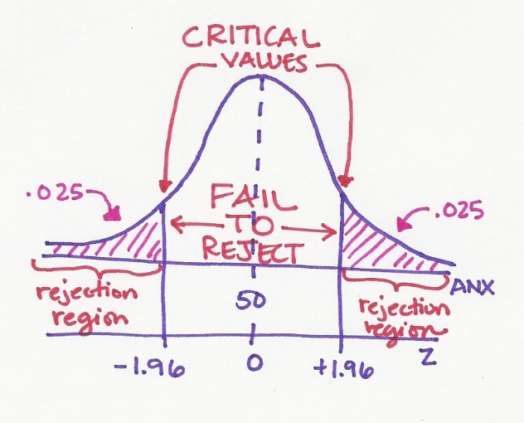

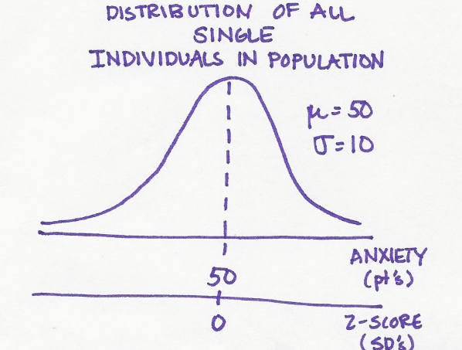
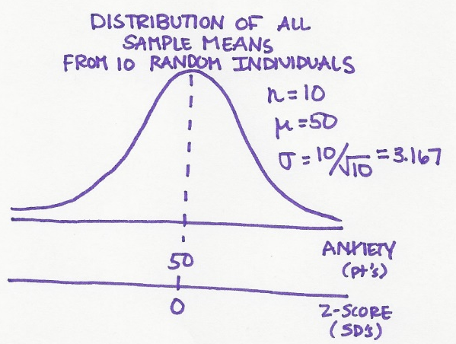
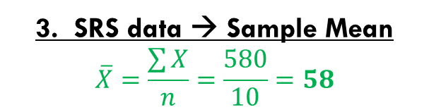

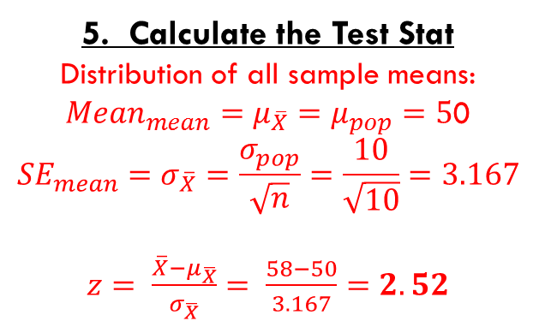
EXAMPLE: 1-sample z-test
Assume the general population has an anxiety scale that is expressed as a T score, so that µ = 50 & σ = 10.
After an earthquake hits their town, a random sample of townspeople yields the following anxiety score: 72, 59, 54, 56, 48, 52, 57, 51, 64, 67
1. Null/Alt Hypotheses
$$H_{0}:μ=50$$
$$H_{1}:μ≠50$$
2. Choose Test Stat, α, & # tails
CLT: mean of repeated SRS → normally dist.
→ So use the z-stat
α = .05 & 2 tails (default)
5. Calculate the Test Stat
Distribution of all sample means:
${Mean}_{mean}=μ_{\overline{X}}=μ_{pop}=5$0
$${SE}_{mean}=σ_{\overline{X}}=\frac{σ_{pop}}{\sqrt{n}}=\frac{10}{\sqrt{10}}=3.167$$
$z= \frac{\overline{X}−μ_{\overline{X}}}{σ_{\overline{X}}}= \frac{58−50}{3.167}=2.52$
6. Conclusion
Z-stat falls in the rejection region
evidence the population’s mean is not 50
“reject the Null”
“After the earthquake,
townspeople’s anxiety levels are
higher than 50, on average.”
3. SRS data → Sample Mean
$$\overline{X}=\frac{\sum{X}}{n}=\frac{580}{10}=58$$
4. Rejection Region?
.05 in BOTH tails, so .025 in EACH tail …
Critical z = +/- 1.96 …
Reject if Z-score is > 1.96 or < -1.96

Slide 14
Cautions About Significance Tests
What statistical significance does not mean…
Statistical significance only says whether the effect observed is likely to be due to chance alone because of random sampling.
Statistical significance may not be practically important. That’s because statistical significance doesn’t tell you about the magnitude of the effect, only that there is one.
An effect could be too small to be relevant. And with a large enough sample size, significance can be reached even for the tiniest effect.
A drug to lower temperature is found to reproducibly lower patient temperature by 0.4°Celsius (P-value < 0.01). But clinical benefits of temperature reduction only appear for a 1°decrease or larger.
STATISTICAL significance does NOT mean PRACTICAL significance!!!

Slide 15
Cautions About Significance Tests
Don’t ignore lack of significance
Consider this provocative title from the British Medical Journal: “Absence of evidence is not evidence of absence.”
Having no proof of who committed a murder does not imply that the murder was not committed.
Indeed, failing to find statistical significance in results is not rejecting the null hypothesis. This is very different from actually accepting it. The sample size, for instance, could be too small to overcome large variability in the population.
When comparing two populations, lack of significance does NOT imply that the two samples come from the same population. They could represent two very distinct populations with similar mathematical properties.

Slide 16
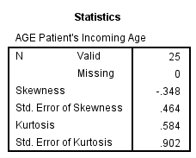
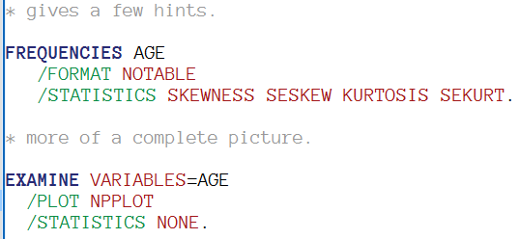
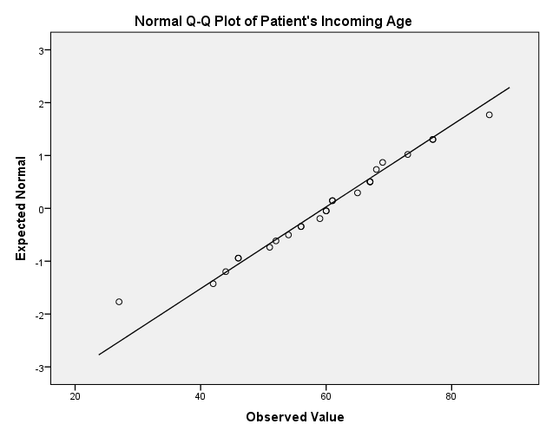
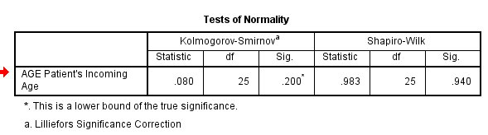
SPSS: testing assumptions
Skewness & Kurtosis
Divide value by its SE
> ± 2 indicates issues

